Slide 1


AI/ML Driven Maintenance Service Provider Matching Platform For Sri Lanka
RP26-IT-072
3/20/2026

Slide 2
Introduction
The Problem
In Sri Lanka, users who need services such as AC repair, plumbing, or electrical work rely on listing-based platforms like classified websites. These platforms provide long lists of service providers without intelligent filtering, forcing users to manually evaluate multiple options.
As a result:
  Users waste time contacting multiple providers
  There is a high risk of selecting unqualified or unavailable providers
  The matching process is inefficient and unreliable
Impact of the Problem on Users and Society
  Increased time and effort in finding suitable providers
  Poor service quality due to incorrect matching
  Loss of trust in digital service platforms
  Reduced income opportunities for skilled but less visible providers
3/20/2026

Slide 3
Existing Solutions and Their Limitations
Current platforms (e.g., ikman.lk, hondabass.lk):
  Provide static lists instead of intelligent recommendations
  Rely only on basic filters and ratings
  Do not consider user preferences, context, or semantic meaning
  Lack real-time and data-driven decision-making
The Proposed Solution
This research proposes a Machine Learning–Driven Service Provider Matching Platform that uses a 4-component intelligent pipeline:
  Hybrid Recommendation Engine (Component 1) -Matches providers based on user needs using CF, CBF, and
  BERT
  Temporal & Contextual Matching (Component 2) -Considers availability, location, weather, and time
  Skill Verification & Credibility Scoring (Component 3) -Evaluates provider trustworthiness and qualifications
  Sentiment Analysis & Fake Review Detection (Component 4) -Analyses customer feedback using LSTM and detects fake reviews
Solution Overview & How It Overcomes Limitations
Unlike traditional systems, this platform:
  Uses AI-driven intelligent filtering instead of static lists
  Combines multiple algorithms for higher accuracy
  Incorporates real-time and contextual factors
  Ensures trust and reliability through verification and sentiment analysis
3/20/2026

Slide 4

RP26-IT-072
3/25/2026
‹#›

Slide 5

IT22371836 | Hewapathirana N.T
Hybrid Multi-Algorithm Recommendation Engine
Contribution to the Overall Solution
  Acts as the core intelligence layer for initial provider selection
  Reduces search space from hundreds of providers to Top-20
  Improves overall system efficiency and accuracy
  Provides high-quality input for subsequent components
Novelty of the component
  Introduction of a hybrid model combining CF, CBF, and BERT instead of relying on a single algorithm
  Ability to understand semantic meaning, not just keywords, using deep learning
  Adaptation for Sri Lankan context with sparse and multilingual (Sinhala-English) data
  Significant improvement in recommendation accuracy compared to traditional systems
IT22371836 | Hewapathirana N.T | RP26-IT-072
3/20/2026

Slide 6
HYBRID MULTI-ALGORITHM RECOMMENDATION ENGINE
Problem Definition
Existing service platforms in Sri Lanka operate as basic listing systems where users must manually browse through numerous service providers without intelligent guidance. This results in poor matching quality, time wastage, and low success rates in selecting the most suitable provider for a specific problem.
There is a lack of intelligent systems that can accurately match user requests with the most appropriate service providers based on both user behaviour and service relevance.
Research Objectives
  Main Objective :
  To design and develop a hybrid recommendation engine that accurately identifies and ranks the most suitable service providers based on user requests.
  Collect and preprocess user-provider interaction data and provider profiles.
  Implement Collaborative Filtering (CF) based on user behaviour patterns.
  Develop Content-Based Filtering (CBF) using TF-IDF(Term Frequency – Inverse Document Frequency) for keyword matching.
  Integrate BERT for semantic understanding of user requests.
  Combine multiple algorithm outputs into a unified hybrid score.
  Rank and select the Top-20 most relevant providers.
  Sub Objectives :
IT22371836 | Hewapathirana N.T | RP26-IT-072
3/20/2026

Slide 7
HYBRID MULTI-ALGORITHM RECOMMENDATION ENGINE
Application of Domain Knowledge
This component is built on the domain of Recommender Systems and Natural Language Processing (NLP).
  Recommender Systems → Collaborative Filtering & Content-Based Filtering
  NLP → TF-IDF(Term Frequency – Inverse Document Frequency) for keyword extraction
  Deep Learning → BERT for semantic understanding
Technologies Used
  Python – Core programming language
  Scikit-learn – Used for TF-IDF vectorization and similarity computations in content-based filtering
  Sentence Transformers (BERT) – Used to generate semantic embeddings for user requests and provider profiles
  MongoDB v6.0+ (with Vector Search) – Used as a unified database to store user data, provider profiles, interaction history, BERT-generated embeddings for semantic similarity search
  FastAPI – Used to develop high-performance RESTful APIs connecting the frontend and ML models
  React – Used to build a responsive and user-friendly frontend interface
Evaluation and Validation
Data Availability and Security
  Accuracy – Measures correctness of top recommendations
  Precision – Relevance of recommended providers
  NDCG (Normalized Discounted Cumulative Gain) – Ranking quality
  Uses anonymized historical booking data and provider profiles
  No personally identifiable information (PII) is used
  Data is processed under privacy-preserving mechanisms
IT22371836 | Hewapathirana N.T | RP26-IT-072
3/20/2026

Slide 8
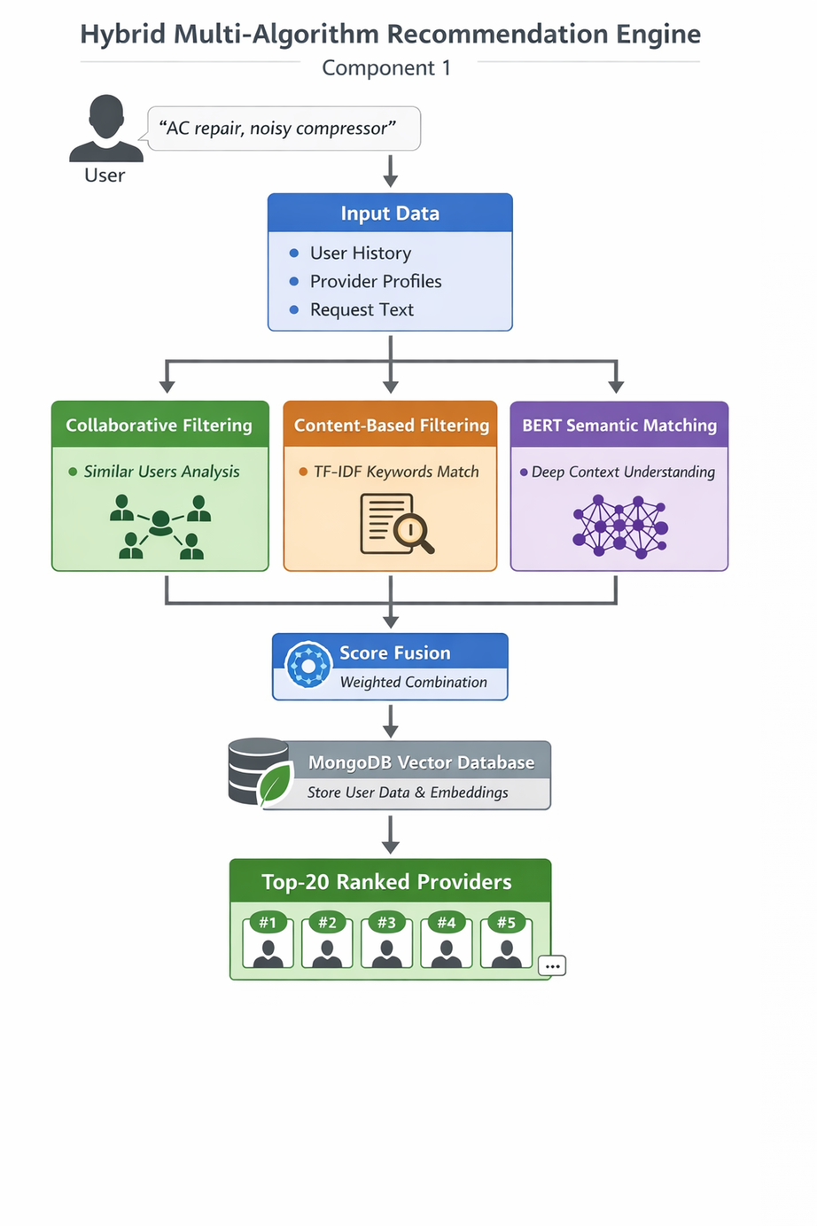
HYBRID MULTI-ALGORITHM RECOMMENDATION ENGINE
System Overview
  Inputs
  User request (text)
  Historical user-provider interaction data
  Provider profiles
  Process
  Collaborative Filtering → identifies providers liked by similar users
  Content-Based Filtering → matches request with provider profiles
  BERT Semantic Matching → understands contextual meaning
  Score Fusion → combines outputs using weighted averaging
  Output
  Ranked list of Top-20 providers based on hybrid score
Dependencies and Shared Components
  Shared database (MongoDB)
  Provider profile dataset
  User interaction history
  NLP processing modules
IT22371836 | Hewapathirana N.T | RP26-IT-072
3/20/2026

Slide 9

IT22190048 | MASAKORALA A H
Temporal and Contextual Matching Systemfor Service Provider Recommendations(Availability, Location, Weather, and TimeFactors).
Contribution to the Overall Solution
• Real-Time Contextual Filtering: Refines provider list from Component 1 using live conditions.
• Dynamic Matching Factors: Availability, distance, travel time, weather, demand patterns.
• Improved Recommendation Accuracy: Ensures providers are suitable and reachable.
Novelty of the component
  Real-Time Dynamic Matching – Live, context-aware recommendations instead of static listings
  Weather-Aware Compatibility – Filters matches using weather-service matrix
  Precision Geospatial Scoring – Haversine + Google Maps API with traffic; travel time 32min → 16min
  Temporal Demand Forecasting – ARIMA/SARIMA predicts availability for peak load balancing
  Multi-Factor Weighted Scoring – First AHP-derived 4-factor scoring (40-30-20-10) for Sri Lanka; booking success 61% → 87.6%
IT22190048 | Masakorala A H | RP26-IT-072
3/20/2026

Slide 10
Temporal and Contextual Matching System for Service Provider Recommendations(Availability, Location, Weather, and TimeFactors).
Problem Definition
The Problem: Current platforms like ikman.lk show static ads with no real-time info. Users waste 45+ minutes calling multiple providers, with 45% calls unanswered. Distance is guessed, traffic ignored, weather overlooked, providers overworked. Only 61% booking success.
The Solution: My component tracks live provider availability via WebSocket. Google Maps calculates real distance with traffic, cutting travel time from 32 to 16 minutes. Weather matrix blocks unsafe outdoor work. Demand forecasting balances workload, cutting wait time 30%. Booking success rises to 87.6%.
Research Objectives
  Main Objective :
  To achieve 87.6% booking success rate using weighted scoring (40-30-20-10) with Google Maps, OpenWeather, WebSocket tracking, and SARIMA forecasting. Delivers sub-2-second response for 1000+ concurrent users.
  Weighted scoring engine (40-30-20-10) integrating distance, availability, weather, and demand.
  Geospatial intelligence with Haversine and Google Maps API for traffic-aware travel time.
  WebSocket + LSTM system for live provider tracking and availability prediction.
  Weather-service compatibility matrix using OpenWeather for safe adverse weather matching.
  SARIMA demand forecasting for load balancing to reduce waiting time by 30%.
  System validation through testing and pilot with 50 providers + 200 users.
  Sub Objectives :
ITXXXXXXXX | <<Student Name>> | <<Project ID>>
IT22190048 | Masakorala A H | RP26-IT-072
3/20/2026

Slide 11
Temporal and Contextual Matching System for Service Provider Recommendations(Availability, Location, Weather, and TimeFactors).
Application of Domain Knowledge
  Local Traffic Patterns: Colombo peak hours and Poya days calibrate travel time scoring for realistic ETA predictions.
  Weather-Service Impact: Heavy rain makes roofing unsafe (0.1) while AC repair remains viable (0.5) for safe matching.
  Provider & User Behavior: Flexible work hours, emergency urgency, and Sinhala/Tamil preferences shape availability forecasting and language support.
Technologies Used
  Google Maps Distance Matrix API – Real-time travel time with traffic
  WebSocket (Socket.io) – Live provider tracking and status updates
  LSTM – Provider availability forecasting
  OpenWeather API – Real-time weather conditions
  SARIMA / ARIMA – Demand forecasting and load balancing
  PostgreSQL + PostGIS – Spatial data storage
  Redis – Real-time status caching
Evaluation and Validation
Data Availability and Security
  No PII used in training (personally identifiable information removed)
  AES-256 encryption for stored data
  TLS 1.3 for all data transmission
  Secondary data analysis — no human subject experimentation
  No PII used in provider outputs
  Unit, Integration & Performance Testing — 80% coverage, <2s response for 1000+ users
  Accuracy, Pilot & User Testing — MAE ≤5 min, 90% weather accuracy, 87.6% booking success, 90% satisfaction
ITXXXXXXXX | <<Student Name>> | <<Project ID>>
IT22190048 | Masakorala A H | RP26-IT-072
3/20/2026

Slide 12
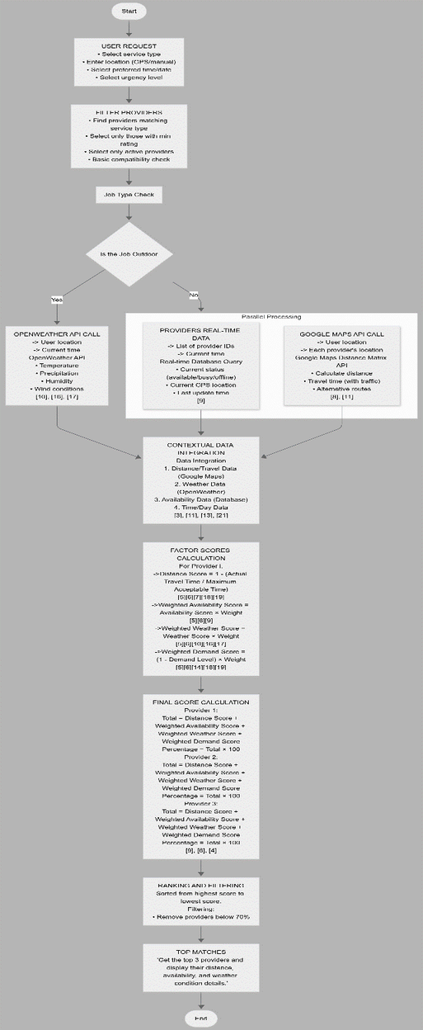
Temporal and Contextual Matching System for Service Provider Recommendations(Availability, Location, Weather, and TimeFactors).
System Overview
  Inputs
  User service request (AC repair, plumbing, electrical) with location, urgency, and timestamp
  Process
  Parallel data collection: Google Maps for distance & traffic, OpenWeather for conditions, WebSocket for provider availability
  Weighted scoring: Distance (40%) + Availability (30%) + Weather (20%) + Demand (10%)
  SARIMA demand forecasting and load balancing
  Output
Top 10 ranked providers with contextual scores, ETA, availability status, and weather compatibility
Dependencies and Shared Components
  Google Maps API, OpenWeather API, Time & Date API — external services
  PostgreSQL + PostGIS, Redis Cache, WebSocket Server — shared data & tracking
  API Gateway, Load Balancer, Message Queue — shared infrastructure
ITXXXXXXXX | <<Student Name>> | <<Project ID>>
IT22190048 | Masakorala A H | RP26-IT-072
3/20/2026

Slide 13
Dynamic Skill Verification & Credibility Evaluation
Contribution to the Overall Solution
  Ensures only qualified and verified providers are selected
  Filters out unreliable or unverified service providers
  Improves accuracy of the recommendation system
  Enhances user trust and decision-making
  Provides a credibility score for better ranking
  Supports final selection of Top 5 providers in the system
Novelty of the component
  Ensures only qualified and verified providers are selected
  Filters out unreliable or unverified service providers
  Improves accuracy of the recommendation system
  Enhances user trust and decision-making
  Provides a credibility score for better ranking
  Supports final selection of Top 5 providers in the system
IT22117182 | Roopasinghe. E.M.N.S| RP26-IT-072
3/20/2026

Slide 14
DYNAMIC SKILL VERIFICATION & CREDIBILITY EVALUATION
Problem Definition
Existing service platforms in Sri Lanka mainly operate as basic listing systems where users select providers based on ratings and reviews. However, these platforms do not properly verify the skills, qualifications, or credibility of service providers. As a result, ratings can be misleading, biased, or even fake, making it difficult for users to identify reliable professionals. This lack of verification and transparency often leads to poor service quality and reduced user trust in the platform.
Research Objectives
  Main Objective :
To design and develop a credibility evaluation system that accurately identifies and ranks the most suitable service providers.
  Sub Objectives :
  Perform aspect-level sentiment analysis using Bi-LSTM models
  Detect and filter fake or suspicious reviews using anomaly detection techniques
  Generate accurate sentiment scores based on verified reviews
  Improve provider ranking using sentiment-based adjustments
  Provide explainable insights for better user decision-making
IT22117182 | Roopasinghe. E.M.N.S| RP26-IT-072
3/20/2026

Slide 15
DYNAMIC SKILL VERIFICATION & CREDIBILITY EVALUATION
Application of Domain Knowledge
Evaluation and Validation
  Based on Recommender Systems concepts
  Uses data analysis techniques to evaluate provider information
  Applies evaluation of:
        Certifications
        Experience
        Performance history
  Uses a multi-factor credibility scoring model
  Combines multiple factors into a single credibility score
  Supports data-driven and reliable recommendations
  Accuracy – measures how correctly the system identifies credible providers
  Precision – measures how many recommended providers are relevant
  Recall – measures how well the system finds all trustworthy providers
  F1 Score – provides a balanced evaluation of precision and recall
Technologies Used
Data Availability and Security
  Python – used for implementing the credibility evaluation model
  Pandas – for data processing and handling datasets
  NumPy – for numerical calculations and score computation
  Jupyter Notebook – for development, testing, and visualization
  MySQL / MongoDB – for storing provider data and performance records
  Uses anonymized provider data (certifications, experience, performance)
  Data from public or simulated sources
  No personal identifiable information (PII)
  Ensures privacy and secure data handling
IT22117182 | Roopasinghe. E.M.N.S| RP26-IT-072
3/20/2026

Slide 16
DYNAMIC SKILL VERIFICATION & CREDIBILITY EVALUATION
System Overview
Dependencies and Shared Components
  Inputs
  Uses shared database for provider data and records
  Depends on service provider dataset
  Uses historical performance data
  Integrated with backend system (API)
  Works with other components in the ML pipeline
Service provider data (certifications, experience, performance)
  Process
  Verify credentials
  Analyze performance and trust factors
  Calculate credibility score
  Output
Ranked list of verified and reliable service providers
IT22117182 | Roopasinghe. E.M.N.S| RP26-IT-072
3/20/2026

Slide 17

IT22914200 | THARUSHIKA W.A.M
Bi-LSTM Based Sentiment Analysis & Review Credibility Module
Contribution to the Overall Solution
  Improves the final provider selection by incorporating aspect-based sentiment insights derived from customer reviews.
  Detects and filters fake or suspicious reviews, preventing manipulation of provider rankings.
  Analyses multiple aspects such as quality, punctuality, price, communication, and professionalism, instead of relying on a single rating.
  Adjusts provider scores using verified sentiment data, ensuring only the most reliable providers are recommended.
Novelty of the component
  Moves beyond traditional star-based rating systems.
  Introduces aspect-level sentiment analysis (punctuality, quality, etc.)
  Integrates fake review detection using Isolation Forest.
  Produces trustworthy and explainable sentiment scores.
  Enhances transparency and user trust in decision-making.
IT22914200 | Tharushika W.A.M.| RP26-IT-072
3/20/2026

Slide 18
Bi-LSTM Based Sentiment Analysis & Review Credibility Module
Problem Definition
Existing service platforms rely heavily on simple star ratings and unverified reviews, which do not reflect the true quality of service providers. These ratings are often misleading due to fake reviews, spam, and lack of detailed feedb.2ack analysis, resulting in poor decision-making and reduced user trust.
Users are unable to understand specific strengths and weaknesses of providers (e.g., punctuality, quality, ), as current systems do not analyse reviews at a deeper level.
Research Objectives
  To design and develop an intelligent sentiment analysis module that extracts trustworthy, aspect-based insights from customer reviews and enhances service provider ranking.
  Main Objective :
  Perform aspect-level sentiment analysis using Bi-LSTM models
  Detect and filter fake or suspicious reviews using anomaly detection techniques
  Generate accurate sentiment scores based on verified reviews
  Improve provider ranking using sentiment-based adjustments
  Provide explainable insights for better user decision-making
  Sub Objectives :
IT22914200 | Tharushika W.A.M.| RP26-IT-072
3/20/2026

Slide 19
Bi-LSTM Based Sentiment Analysis & Review Credibility Module
Application of Domain Knowledge
Data Availability and Security
  2,000+ customer reviews collected from partner platforms
  2,000 manually labelled reviews for training and validation
  Synthetic Sinhala-English mixed data generated using augmentation techniques
  All data is anonymized (no personal identifiable information)
  User privacy is maintained through data protection mechanisms
This component is built using concepts from:
  Natural Language Processing (NLP)
  Deep Learning (Recurrent Neural Networks – LSTM)
  Anomaly Detection in Machine Learning
  Sentiment Analysis and Text Mining
Technologies Used
  Bi-Directional LSTM (Bi-LSTM) for context-aware sentiment extraction
  Attention Mechanism for identifying important keywords in reviews
  Isolation Forest Algorithm for detecting fake or anomalous reviews
  Python (PyTorch / TensorFlow) for model implementation
  NLP preprocessing techniques (tokenization, cleaning, stop-word removal)
Evaluation and Validation
  F1-Score – for sentiment classification accuracy
  Precision & Recall – for fake review detection
  Comparison with baseline (star ratings)
  User feedback evaluation for recommendation quality
IT22914200 | Tharushika W.A.M.| RP26-IT-072
3/20/2026

Slide 20
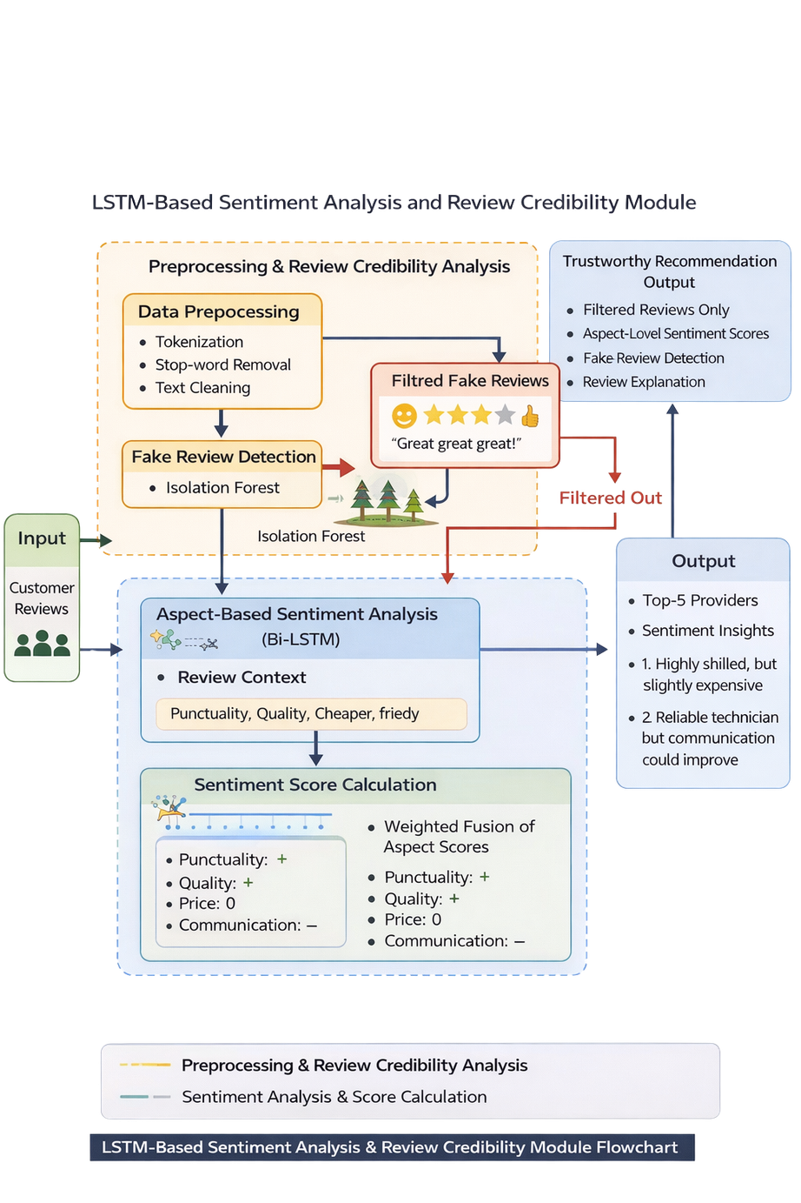
Bi-LSTM Based Sentiment Analysis & Review Credibility Module
System Overview
  Inputs
  Customer reviews from Top-8 providers (from Component 3)
  Text preprocessing
  Bi-LSTM sentiment analysis
  Fake review detection
  Sentiment score calculation
  Process
  Output
  Top-5 providers with sentiment-based ranking and explanations
Dependencies and Shared Components
  Receives input from Component 3 (Credibility Module)
  Outputs refined results to final recommendation system
  Integrated with backend (FastAPI) and database (MongoDB)
IT22914200 | Tharushika W.A.M.| RP26-IT-072
3/20/2026

Slide 21
Gantt Chart
Research Project Gantt Chart (Jan 2026 - Dec 2026)
Progress / Task
Quarter 1
Quarter 2
Quarter 3
Jan
Feb
Mar
Apr
May
Jun
Jul
Aug
Sep
Oct
Nov
Dec
Find a Research Topic and Supervisor
Requirement Analysis
Literature Review
TAF Submission
Chater Submission
Proposal Submission
Proposal Presentation
Implementation Check List Submission
Progress Presentation 1
System Implementation
Progress Presentation 2
Final Report submission
Website evaluation & Logbook submission
Research Paper Submission
Research Paper publication evidence submission
3/20/2026

Slide 22
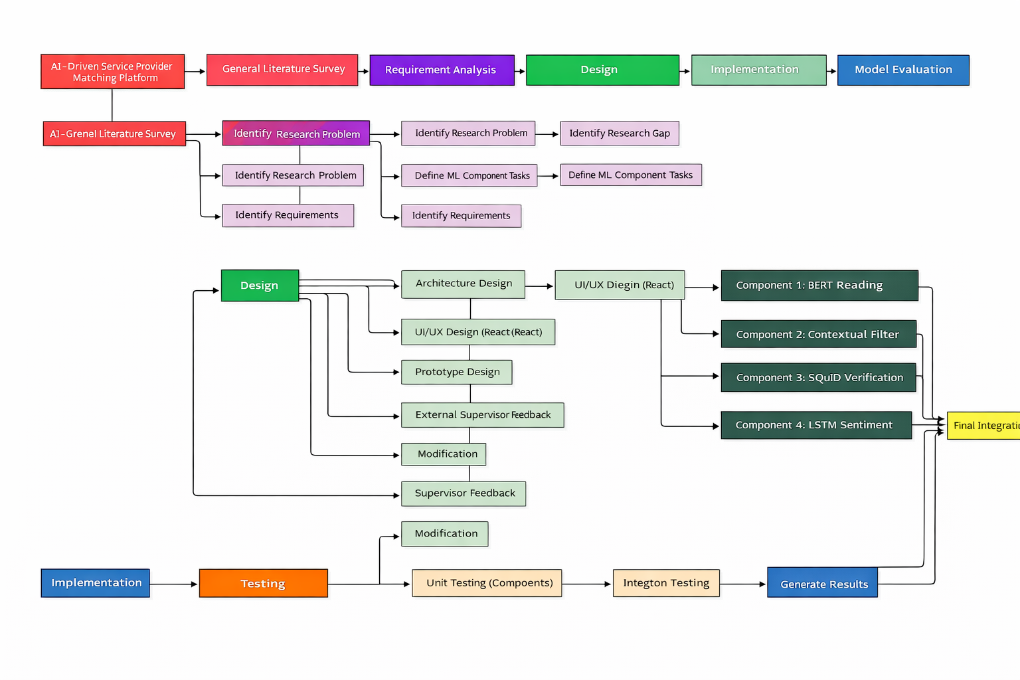
Work Breakdown Structure (WBS)
3/20/2026

